Slide 1
Neuro-Cognitive Output:
Motor Systems

Slide 2
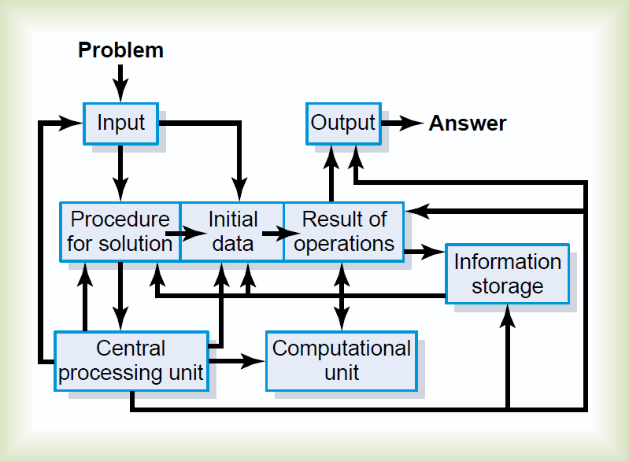
The Brain as a Computer

Slide 3
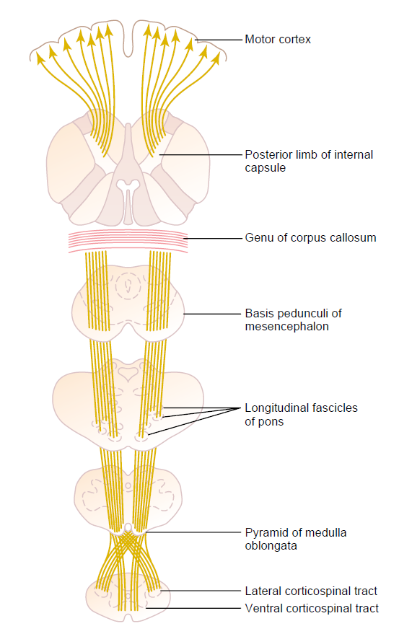
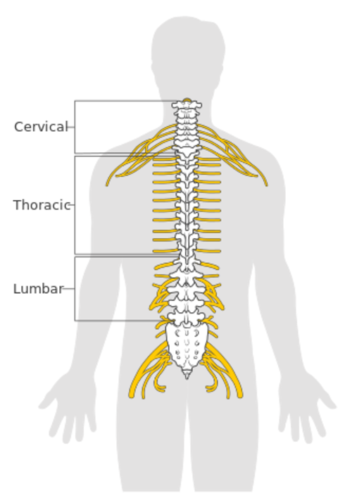
Motor Tract:
Cortico-spinal (Pyramidal) Tract
Pyramidal Cells

Slide 4
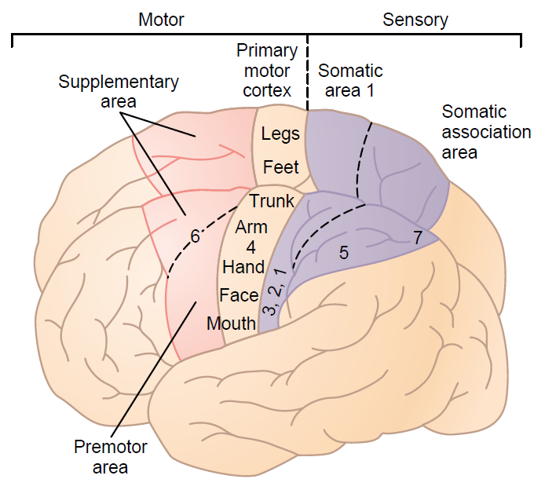
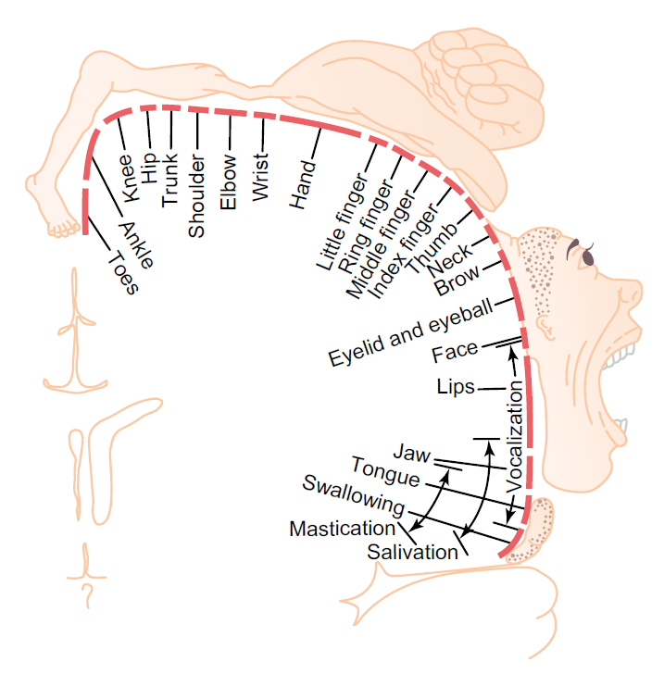
Motor Homunculus

Slide 5
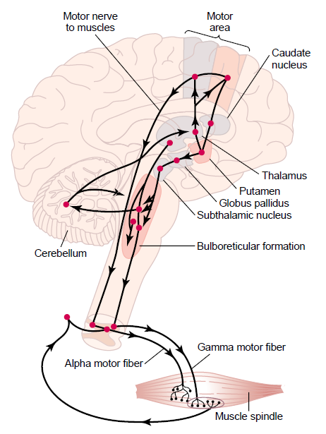
Body’s “Motor” system:
Skeletal Sensory system
(below face)
Basal
Ganglia

Slide 6
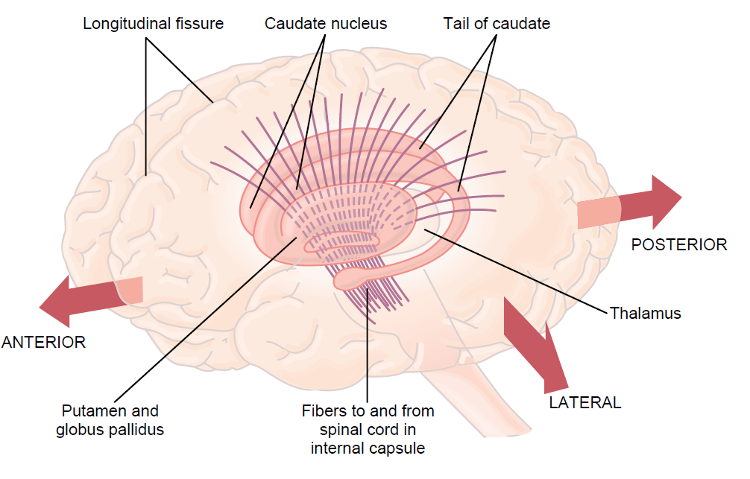
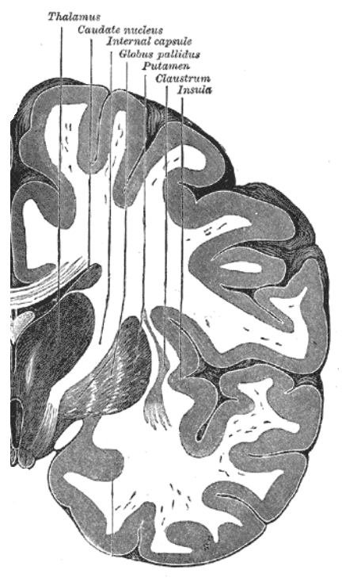
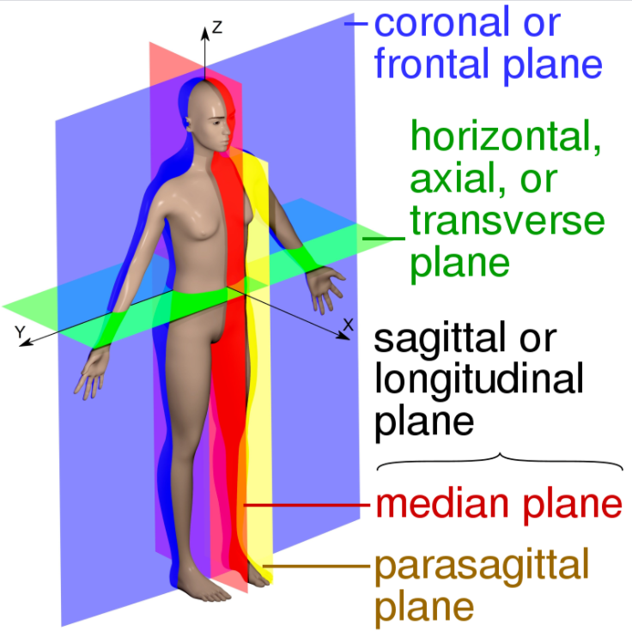
Basal ganglia:
Relay Station between Cerebral Cortex & Spinal Cord, via Thalamus
Coronal (Frontal) View
Sagittal (Side) View
Sections of Human Body

Slide 7
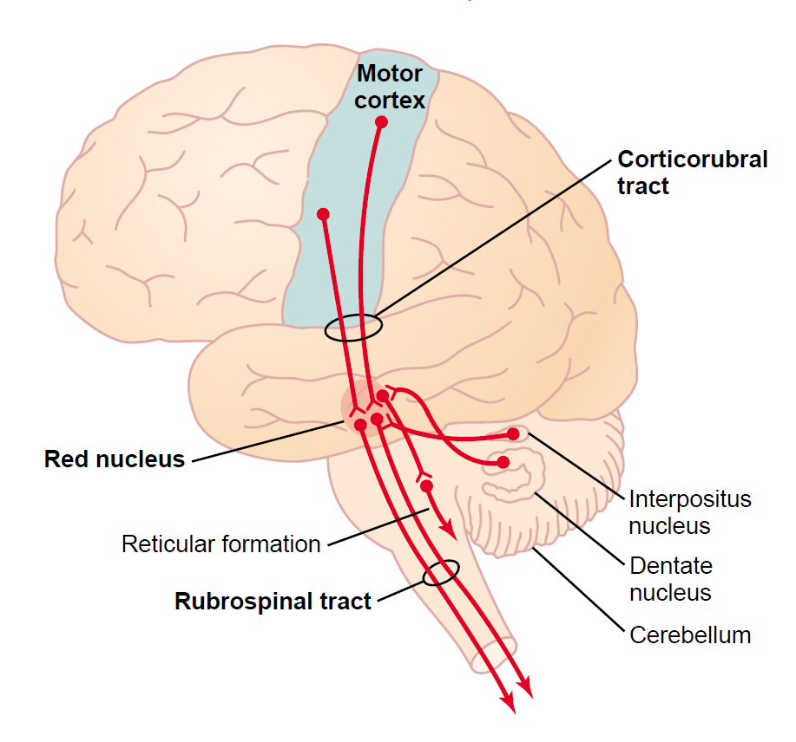
Motor Error Control:
Cortico-rubro-spinal pathway
Cerebellum:
Error Correction

Slide 8
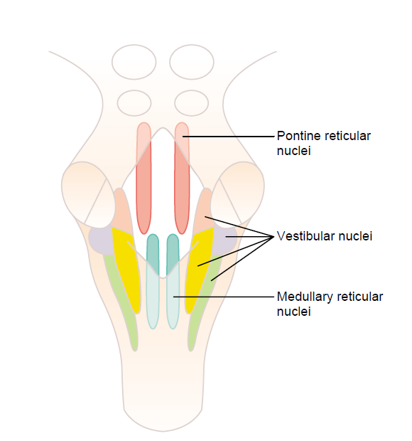
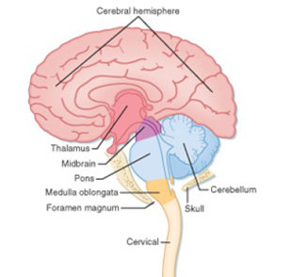
Motor Control of Muscles : From Balancing Receptors (Ear Cochlea):
Via “Vestibular” Nuclei in Brain Stem
Brain Stem →
Cerebral Hemispheres
Brain
Stem
Spinal Cord

Slide 9
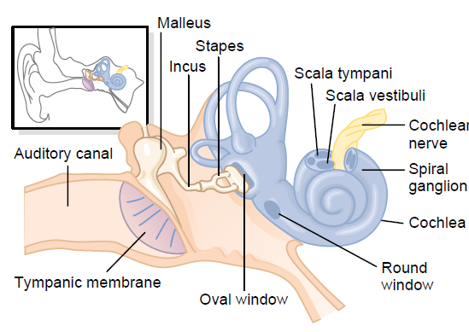
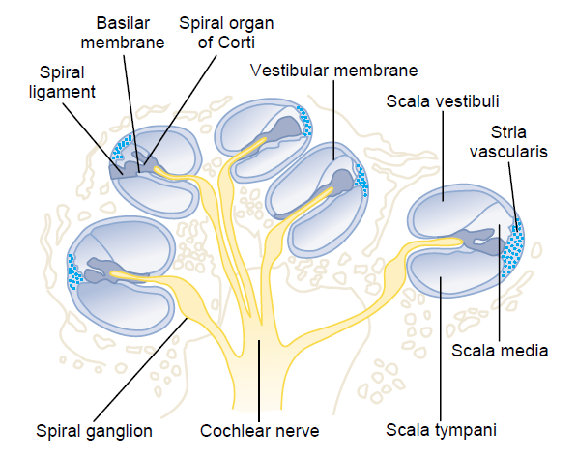
Ear: Vestibular Nerve’s Origin
Hearing & Balance sensing:
Cochlea & Labrynthine system

Slide 10
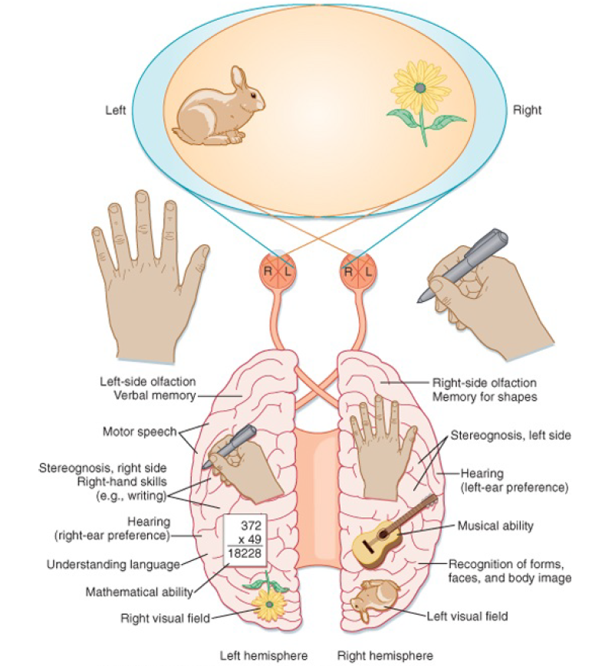
Cerebral Lateralization:
Sensory – Motor Synchronization
Contrasting Functioning of Right / Left Brain

Slide 12
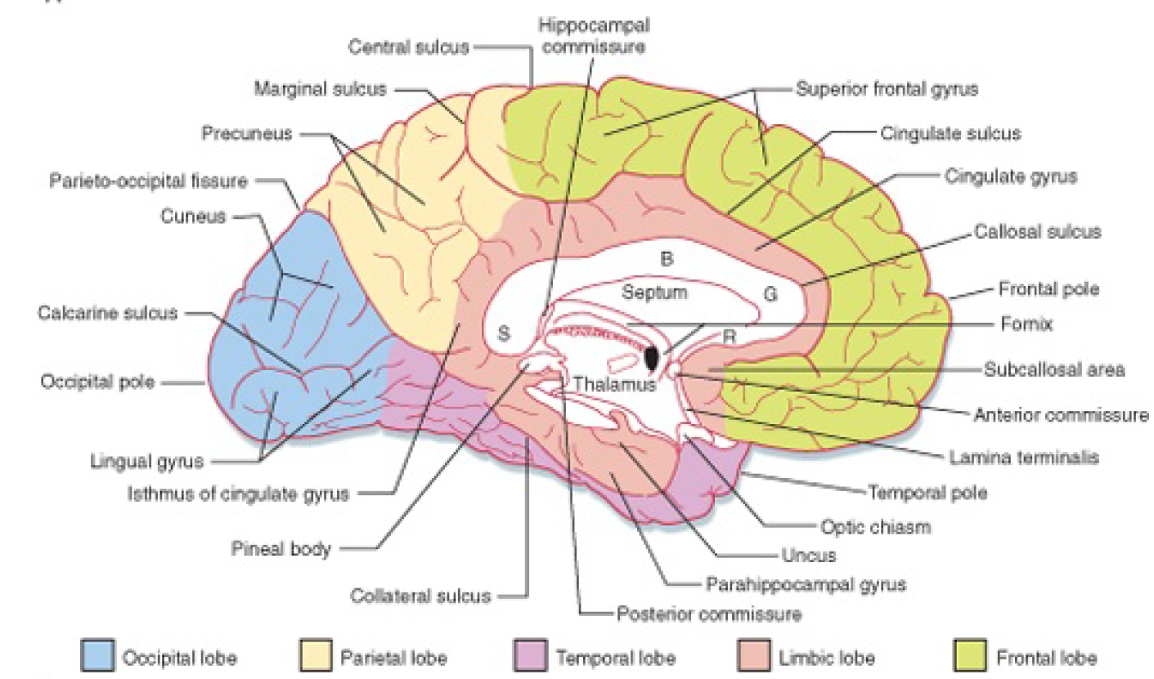
Motor Tracts relays: To Thalamaus & Opposite Cerebral Hemisphere by Corpus Callosum
Behavioral, Emotional & Motivational Mechanisms:
Limbic Lobe : Limbic System & Hypothalamus
Limbic Lobe

